Slide 1
Data Science BootCamp: Module 1
Linear Model Selection (Day 1)
19th February 2018
Rituparno Guha
Prasun Biswas

Slide 2
Some real life situations
Agriculture: Predicting crop yields in this season based on the rainfall.
Marketing and Sales: Impact of product price on the no. of units sold.
Human Resource: Predicting salary of a person based on set of attributes such as years of experience, level of education, industry of work, previous job salary etc.
Real Estate: Predicting House Prices considering house, locality and builder characteristics.
Banks: Predicting revenue of customers and identifying parameters which are linked to increased revenue of the customers. This helps business bankers in realigning the priority and focus.
OI lift prediction could one very specific use case for Fidelity, where we are trying to model incremental Operating Income potential among customers

Slide 3
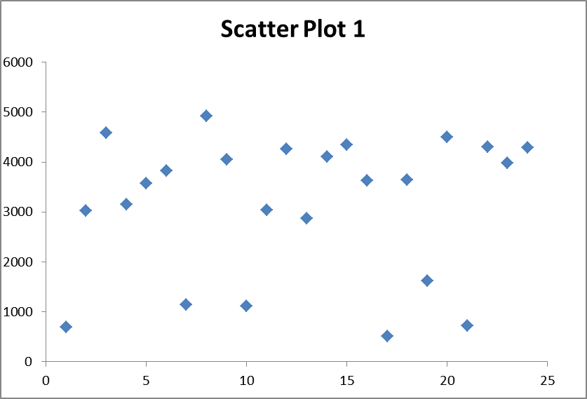
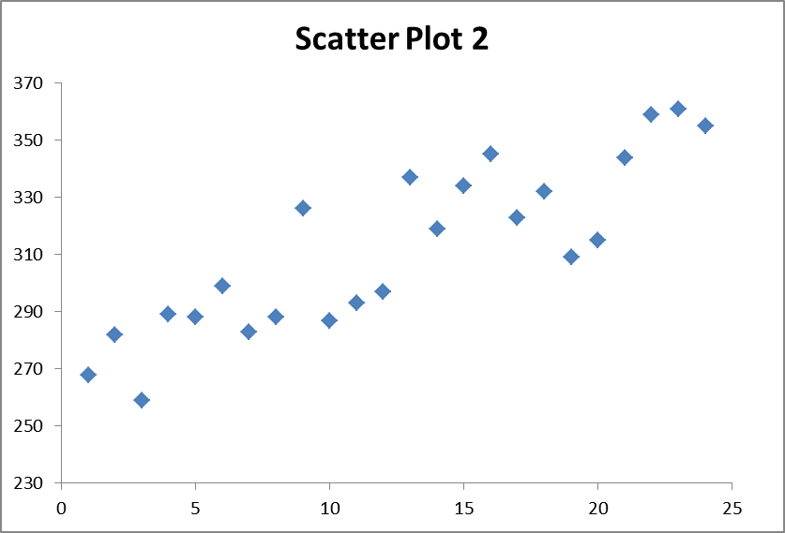
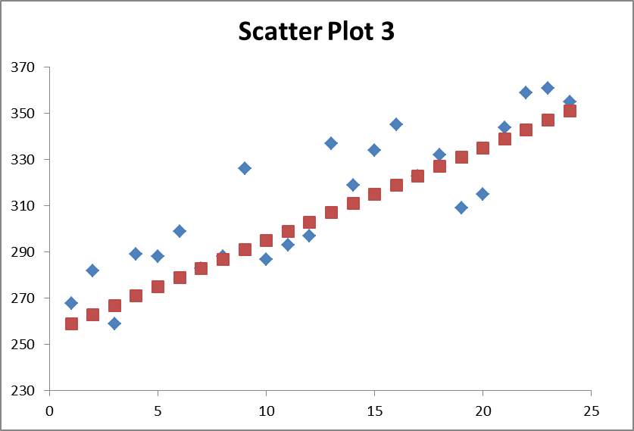
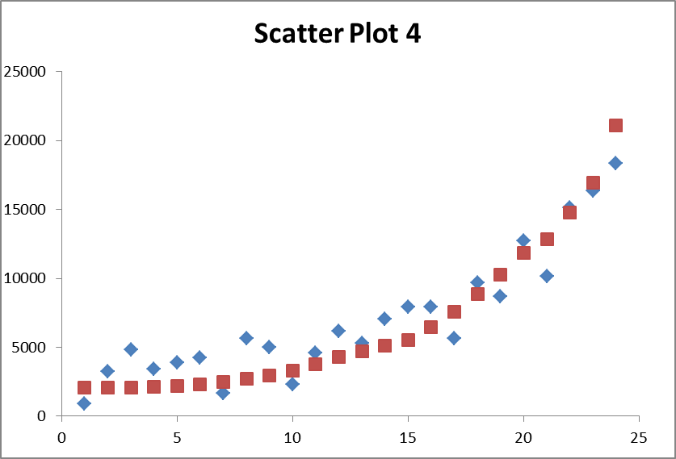
Regression Models
Regression analysis is the study of the dependence of one variable (the dependent variable) on one or more explanatory variables, with a view to estimating/predicting the average values of the former in terms of the known values of the later.
Correlation analysis and regression analysis are closely related but conceptually quite different. Correlation measures the strength of linear association between 2 variables. Regression estimates/predicts the average value of one variables on the basis of the known values of other variable/s.

Slide 4
Linear Regression Models
Population
Random Sample
Unknown Relationship
☺
☺
☺
☺
☺
☺
☺
☺
☺
☺
Relationship Between the dependent variable and the independent variables Is a Linear Function.
Y-Intercept
Population Slope
Random Error
Y
=
β
+
β
X
+
ε
i
0
1
i
i
Dependent (Response) Variable
Independent (Explanatory) Variable

Slide 5
Assumptions for Linear Regression
There should be a linear and additive relationship between dependent variable and independent variable(s). A linear relationship suggests that a change in response Y due to one unit change in X is constant, regardless of the value of X. An additive relationship suggests that the effect of X on Y is independent of other variables.
There should be no correlation between the error terms. Absence of this phenomenon is known as Autocorrelation.
The independent variables should not be correlated. Absence of this phenomenon is known as multicollinearity.
The error terms must have constant variance. This phenomenon is known as homoscedasticity. The presence of non-constant variance is referred to heteroscedasticity.
The mean of the error terms must be 0. Sometimes, an additional assumption is also made that the error terms should follow normal distribution with a mean of 0 and constant variance.
NOTE:
Are Residuals and Errors the same thing?
A statistical error (or disturbance) is the amount by which an observation differs from its expected value,
A residual (or fitting deviation), on the other hand, is an observable estimate of the unobservable statistical error.

Slide 6
What happens if assumptions of OLS are not met?
Consequences of Non-Linearity: When the assumption of linearity is violated, OLS models will yield biased parameter estimates. In general the OLS estimators as well as R-square will be underestimated.
Consequences of Auto-correlation: Autocorrelation inflates t-statistics by underestimating the standard errors of the coefficients, thereby giving un-stabilized model. Hypothesis testing will therefore lead to incorrect conclusions.
Consequences of Heteroscedasticity: Normality of error terms is required for the statistical tests to be valid. Heteroscedasticity results in inefficient estimators (which are not BLUE) and biased standard errors, rendering the t-tests and confidence intervals unreliable. As in the case of autocorrelation, hypothesis testing will lead to incorrect conclusions. The estimators however, remain unbiased.
Consequences of Multicollinearity: Multicollinearity inflates the standard errors, making it impossible to determine the relative importance of the predictors. In other words, the coefficients will be unreliable.
POSSIBLE SOLUTIONS: Refer Case Study

Slide 7
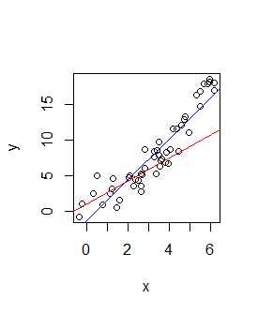
Estimating Linear Models : MLE and OLS
Maximum likelihood (MLE)- In statistics, maximum likelihood estimation (MLE) is a method of estimating the parameters of a statistical model given observations, by finding the parameter values that maximize the likelihood of making the observations given the parameters. Very useful in extensions of simple linear regression such as logistic and Poisson regressions.
Ordinary Least squares (OLS) : Which of the two lines does a better job of describing the relationship?
It turns out that there are some nice formulas for calculating slope and intercept

Slide 8
Ordinary Least Squares & Coefficient Equations
‘Best Fit’ Means Difference Between Actual Y Values & Predicted Y Values Are a Minimum. But Positive Differences Off-Set Negative. So square errors!
LS Minimizes the Sum of the Squared Differences (errors) (SSE)
Prediction equation
Sample slope
Sample Y - intercept

Slide 9
Derivation of Parameters
Least Squares (L-S):
Minimize squared error w.r.t. intercept
Minimize squared error w.r.t. slope
Notes:
SS(xy) : Cov(x,y)
SS(xx) : Var(x)

Slide 10


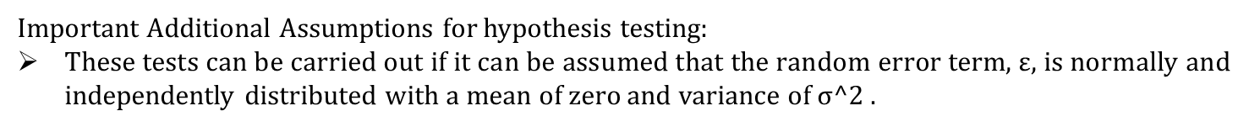
Inference on parameters : Significance of Estimate
Why do we need hypothesis testing on parameter estimates?
From the linear regression fit, we derive estimates based on the SAMPLE.
To have a certain LEVEL OF CONFIDENCE on whether these estimates are TRUE REPRESENTATIVE OF THE POPULATION, we need to do hypothesis testing.
Important Additional Assumptions for hypothesis testing:
These tests can be carried out if it can be assumed that the random error term, $ε$, is normally and independently distributed with a mean of zero and variance of σ^2 .
Test:
Test statistic:
The test statistic follows a t distribution with n-2 degrees of freedom, where n is the total number of observations. The null hypothesis is accepted if the calculated value of the test statistic is such that: where α is the level of significance.
Specifically, in case of regression, we assume that parameter values are 0 as the null hypothesis, and then try to prove/disprove how significantly they are different from 0.

Slide 11
Case Study: Understanding Regression Output (1)
Slope (β₁) : Estimated Y Changes by β₁ for Each 1 Unit Increase in X.
If β ₁ = 2, then Y Is Expected to Increase by 2 for Each 1 Unit Increase in X
Y-Intercept (β₀) : Average Value of Y When X = 0.
If β ₀ = 4, then Average Y Is Expected to Be 4 When X Is 0
The linear regression equation can be written down in the following way:
TSS = SSR + SSE
where TSS: Total Sum of squares,
SSR: Sum of Squares explained by regression
SSE: Sum of squares of residuals
Coefficient of Determination or R-square explains what proportion of the total variation is explained by the regression equation, which obviously implies that higher R-square values indicates better model.
R-square = SSR/TSS = 1 - SSE/TSS
Adjusted R-square: Since R square will continue increasing with each additional regressor (x variable) coming in, it tends to overfit the data. Thus, the concept of adj. R-square was derived, which penalizes unnecessary increasing of variables, and does not necessarily increase with the increase in no. of regressors.
Adjusted Rsquare = 1 - (SSE/(n-p))/(TSS/(n-1))
Notes:
Negative adjusted r square
Degrees of Freedom: Simplistically, degrees of freedom are the number of data points that went into the estimation of the parameters used after taking into account these parameters. For example, if we had 50 data points and two parameters (intercept and slope), df of residuals will be 48.

Slide 12
Case Study(contd.): Understanding Regression Output (2)
Residual Standard Error: Residual Standard Error is measure of the quality of a linear regression fit. Theoretically, every linear model is assumed to contain an error term. Due to the presence of this error term, we are not capable of perfectly predicting our response variable from the predictor one. The Residual Standard Error is the average amount that the response will deviate from the true regression line.
t-statistic value: The coefficient t-value is a measure of how many standard deviations our coefficient estimate is far away from 0. We want it to be far away from zero as this would indicate we could reject the null hypothesis - that is, we could declare a relationship between x and y exist.
P-value of t-test: The Pr(>t) acronym found in the model output relates to the probability of observing any value equal or larger than t. A small p-value indicates that it is unlikely we will observe a relationship between the predictor and response variables due to chance. Typically, a p-value of 5% or less is a good cut-off point.
F-statistic is a good indicator of whether there is a relationship between our predictor and the response variables. The further the F-statistic is from 1 the better it is. However, how much larger the F-statistic needs to be depends on both the number of data points and the number of predictors. Generally, when the number of data points is large, an F-statistic that is only a little bit larger than 1 is already sufficient to reject the null hypothesis and vice-versa.
NOTE: If we see that F-statistic is quite significant in rejecting the null hypothesis, but most of the t statistics are not strong enough in rejecting the respective null hypothesis, then there might be a chance of multi collinearity in the data.
Notes:
Assuming null hypothesis is true in the population , P value is the probability of what the sample says about the null hypothesis. If that is less than 5%, we reject null hyp

Slide 13
Case Study(contd.): Multicollinearity check
Tolerance : In multiple regression, tolerance is used as an indicator of multicollinearity. Tolerance is estimated by 1 – R-square, where R-is calculated by regressing the independent variable of interest onto the remaining independent variables included in the multiple regression analysis. As a point of interest, tolerance may be said to be the opposite of the coefficient of determination. In that sense, tolerance is identical to the coefficient of alienation.
Variance Inflation Factor: In multiple regression, the variance inflation factor (VIF) is used as an indicator of multicollinearity. Computationally, it is defined as the reciprocal of tolerance: 1 / (1 - R2). All other things equal, researchers desire lower levels of VIF, as higher levels of VIF are known to affect adversely the results associated with a multiple regression analysis. In fact, the utility of VIF, as distinct from tolerance, is that VIF specifically indicates the magnitude of the inflation in the standard errors associated with a particular beta weight that is due to multicollinearity. For example, a VIF of 8 implies that the standard errors are larger by a factor of 8 than would otherwise be the case, if there were no inter-correlations between the predictor of interest and the remaining predictor variables included in the multiple regression analysis.

Slide 14
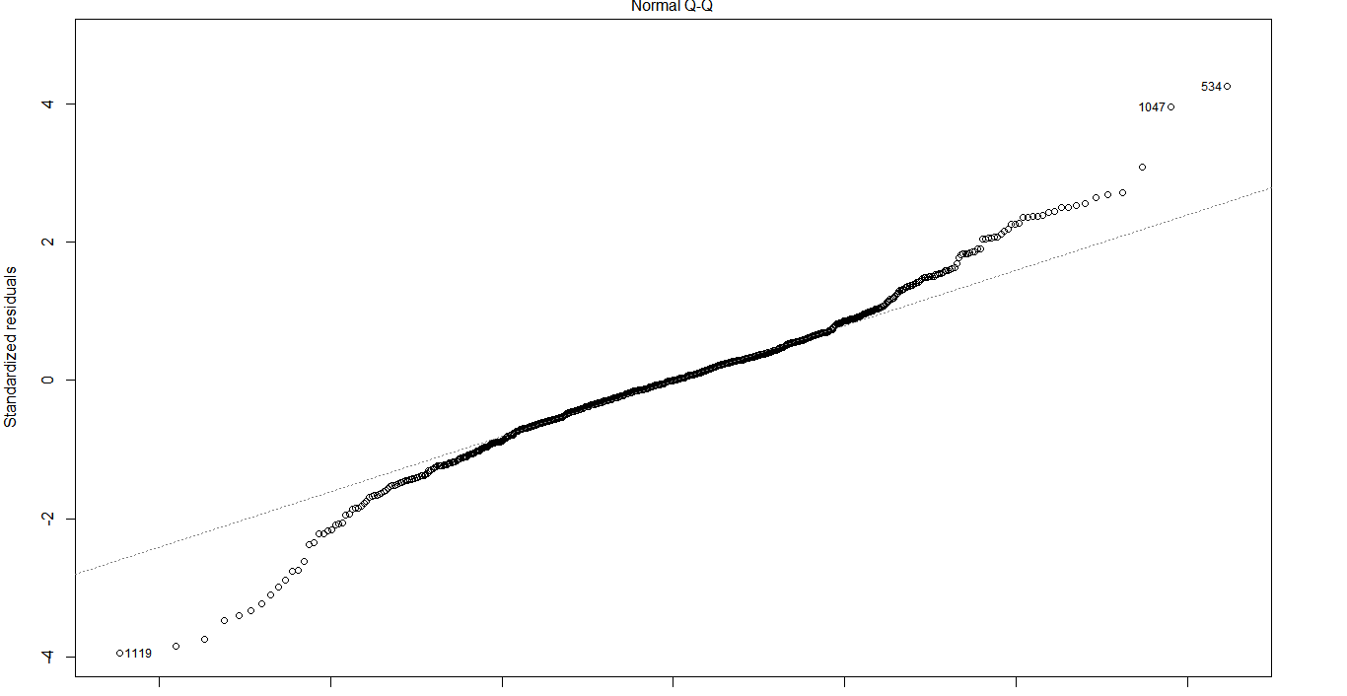
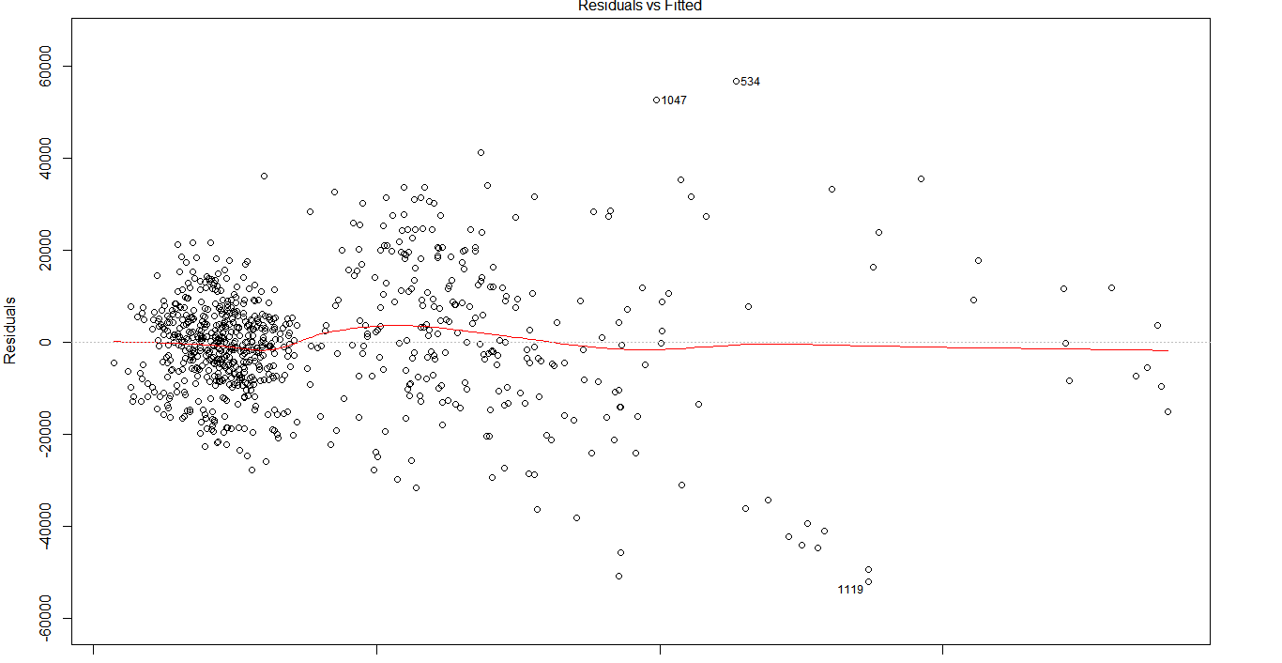
Case Study(contd.): Residual Diagnosis for checking Assumptions-Graphical Method (1)
Some important observations from residual plots:
Residuals are not following normal distribution..
Non linear patterns in the data.

Slide 15
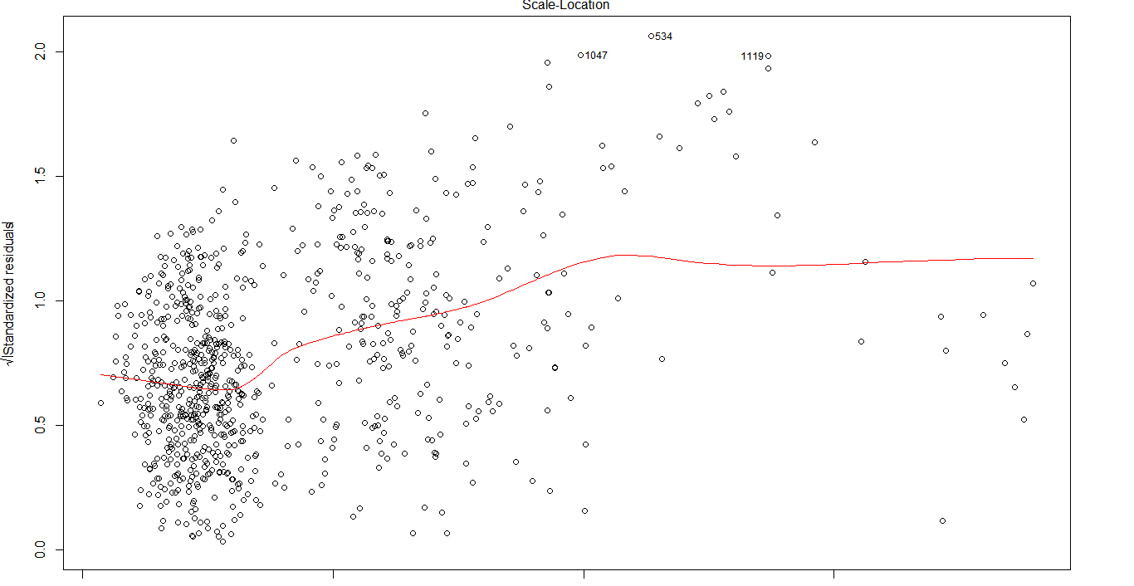
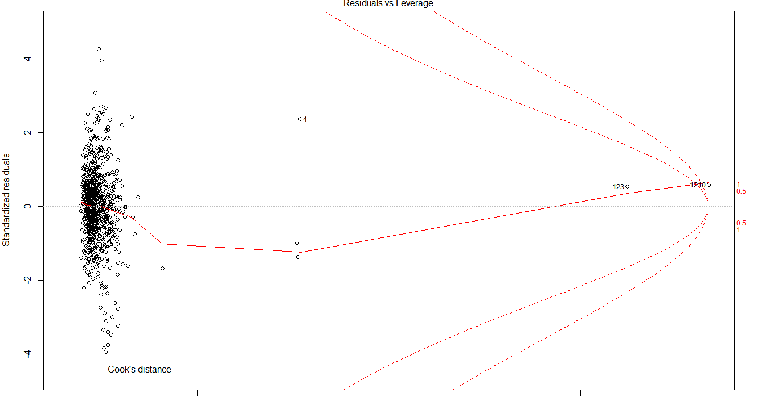
Case Study(contd.): Residual Diagnosis for checking Assumptions–Graphical Method (2)
Some important observations from residual plots:
Heteroscedasticity is present in the data, since residuals are not spread equally among the data.
Based on Cook’s D, we think there are some outliers and leverage points in the data.

Slide 16
Case Study(contd.): Checking for Autocorrelation of Errors and Heteroscedasticity and possible solutions
Durbin Watson Statistic : It is a test statistic used to detect the presence of autocorrelation at lag 1 in the residuals from a regression analysis. The bounds tests for the null hypothesis that the errors are serially uncorrelated against the alternative that they follow a first order autoregressive process is tested with this statistic.
Breusch Pagan Test: It is used to test for heteroscedasticity in a linear regression model. It is a chi-squared test, where if the test statistic has a p-value below an appropriate threshold (e.g. p<0.05) then the null hypothesis of homoscedasticity is rejected.
In case of heteroscedasticity, one could either use weighted least squares (if the source of heteroscedasticity is known) or use heteroscedasticity-consistent standard errors.
Box-cox transformation is a mathematical transformation of the variable to make it approximate to a normal distribution. Often, doing a box-cox transformation of the Y variable solves the issue.
Transformation | Best Lambda
Square | 1.5 to 2.5
None | 0.75 to 1.5
Square-root | 0.25 to 0.75
Natural log | -0.25 to 0.25
Inverse square-root | -0.75 to -0.25
Reciprocal | -1.5 to -0.75
Inverse square | -2.5 to -1.5
Notes:
Box cox transformation equation. Weight least squares are done since Box Cox does not work in case of bi modal data

Slide 17
Case Study(contd.): Checking for Autocorrelation of Errors and Heteroscedasticity and possible solutions
There are two ways of dealing with the problem of autocorrelated errors..
Leave the model specification as is but expand confidence intervals around the regression coefficients to account for the violation of the model assumption of non-autocorrelated errors. This can be done by using heteroscedasticity and autocorrelation (HAC) robust standard errors,.
Pros: easy to use; can retain the original model.
Cons: Wider confidence intervals →→ lower precision, less power (harder to reject null hypotheses); model is misspecified; less accurate forecasting (due to neglecting the autocorrelation in model errors).
Change the model specification to obtain non-autocorrelated errors. For example, run a regression with ARMA errors (easy to implement by arima or auto.arima functions in R including the regressors via the parameter xreg)
Pros: narrower confidence intervals →→ higher precision, more power (easier to reject null hypotheses); model is correctly specified, more accurate forecasting.
Cons: Requires more work; cannot retain the original model.
Check modified model after removing multicollinearity and auto correlation.
Notes:
Variable selection methodology: forward / backward stepwise

Slide 18
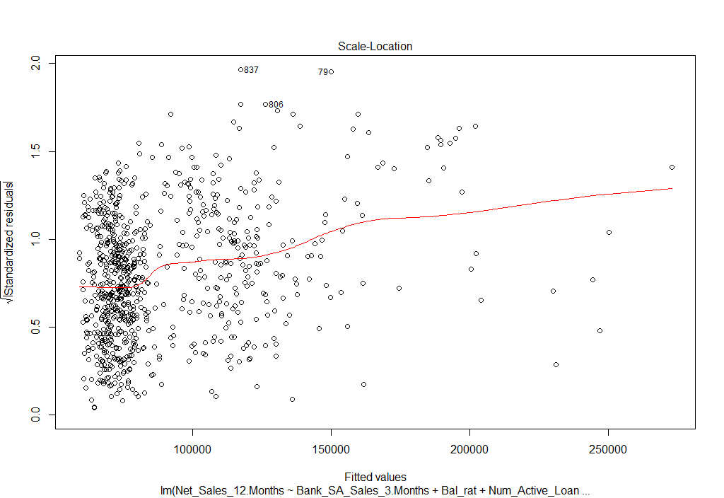
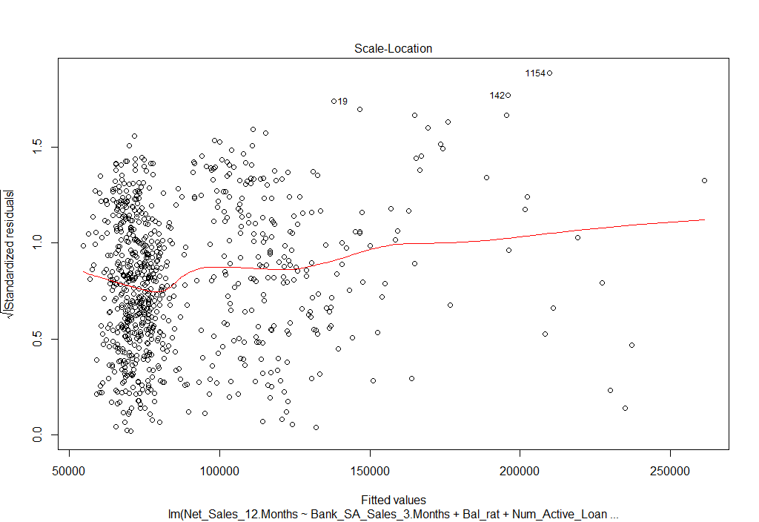
Case Study(contd.): Scale Location Plot after Outlier treatment and using weighted least squares
Only weighted least squares methodology used
Outlier treatment along with weighted least squares methodology

Slide 19
Measures of Model Performance
PRESS statistic : In statistics, the predicted residual error sum of squares (PRESS) statistic is a form of cross-validation used in regression analysis to provide a summary measure of the fit of a model. R square is a popular measure of quality of fit in regression. However, it does not offer any significant insights into how well our regression model can predict future values. Instead, the PRESS statistic (the predicted residual sum of squares) can be used as a measure of predictive power. The PRESS statistic can be computed in the leave-one-out cross validation process, by adding the square of the residuals for the case that is left out. The smaller the value of PRESS statistic, the better it is.
MSE(Mean Square error)
RMSE (Root Mean Square Error)
MAE (Mean Absolute Error)
MAPE (Mean Absolute Percentage Error)
Every measure has their own advantages and disadvantages:
RMSE it's better for showing bigger deviations,
MAE has easiest interpretation . It is less sensitive to the occasional very large error because it does not square the errors in the calculation.
MAPE is useful to compare the precision between different volumes under study.

Slide 20
Comparison of Models : AIC
The magnitude of AIC (Akaike information Criteria) for a specific model is less of interest than the comparison of AICs for two or more models because AIC is usually used in the context of comparing models, not as an absolute criterion in itself.
The usual "rule" for comparing two or more models is to choose the one with the minimum AIC value. This minimum value may or may not be negative. In multiple linear regression, the AIC value is estimated as
N*ln(error-sum-of-squares/N)
+ 2*(number of independent variable parameters including the intercept term),
where N=the number of observations.
If a model were so good that it (almost) perfectly predicted the dependent variable, the error-sum-of squares would approach zero, and the natural logarithm of this value and the AIC would approach negative infinity. Thus, the better the independent variables of this linear regression model are in predicting the dependent variable, the more negative the AIC becomes. However, this "asymptotic" behavior is less important to the usefulness of AIC than the comparison of the AIC values of different models. Smaller AIC values are better when comparing two or more models.

Slide 21
Comparison of Models : BIC
In statistics, the Bayesian information criterion (BIC) or Schwarz criterion (also SBC, SBIC) is a criterion for model selection among a finite set of models; the model with the lowest BIC is preferred. It is based, in part, on the likelihood function and it is closely related to the Akaike information criterion (AIC).
The BIC criterion suffers from two main limitations:
the above approximation is only valid for sample size n much larger than the number k of parameters in the model.
the BIC cannot handle complex collections of models as in the variable selection (or feature selection) problem in high-dimension.

Slide 22
Appendix

Slide 23
Multivariate Regression (1): Multivariate normal Distribution

Slide 24
Multivariate Regression (2): Simple Linear Regression in Matrix Form

Slide 25
Multivariate Regression (3): Estimating Parameters by Least Squares

Slide 26
Multivariate Regression (4): Fitted Values and Residuals

Slide 27
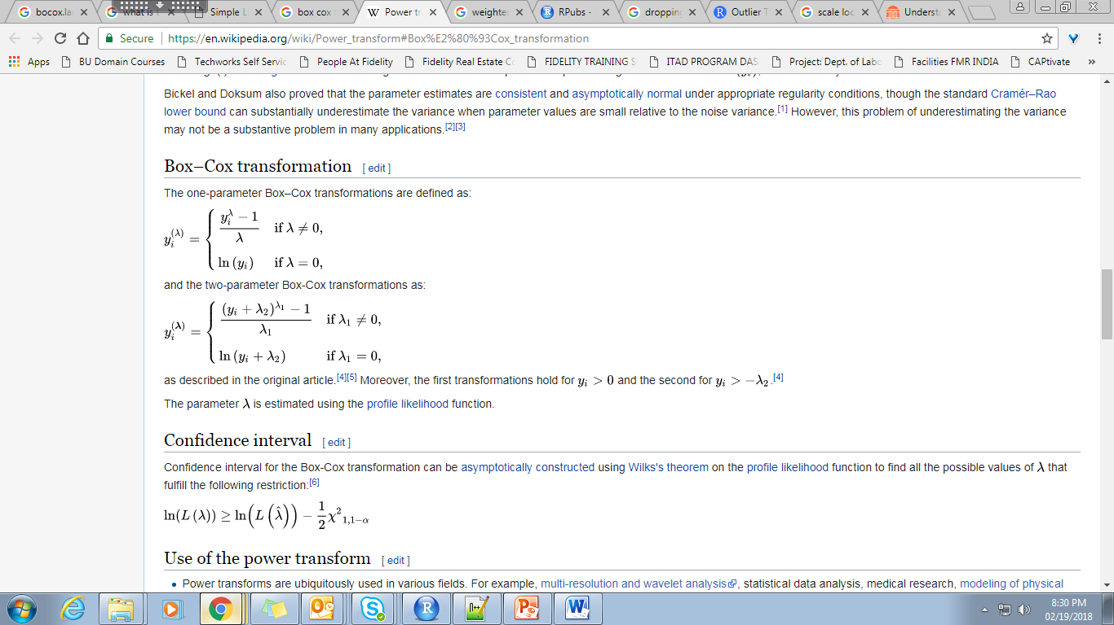
Box-Cox Transformation Equation

Slide 28
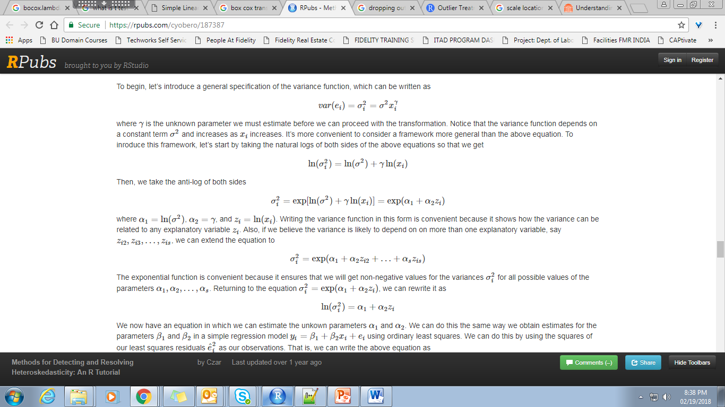
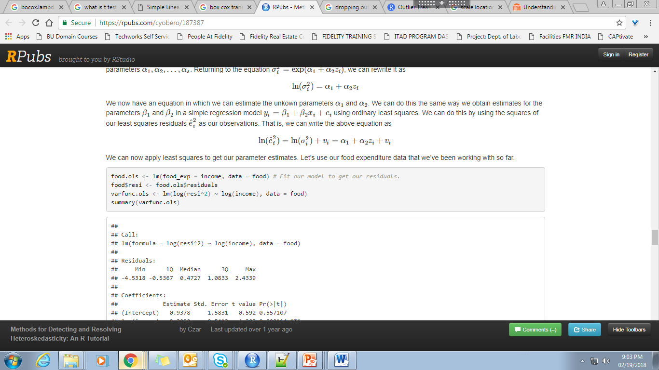
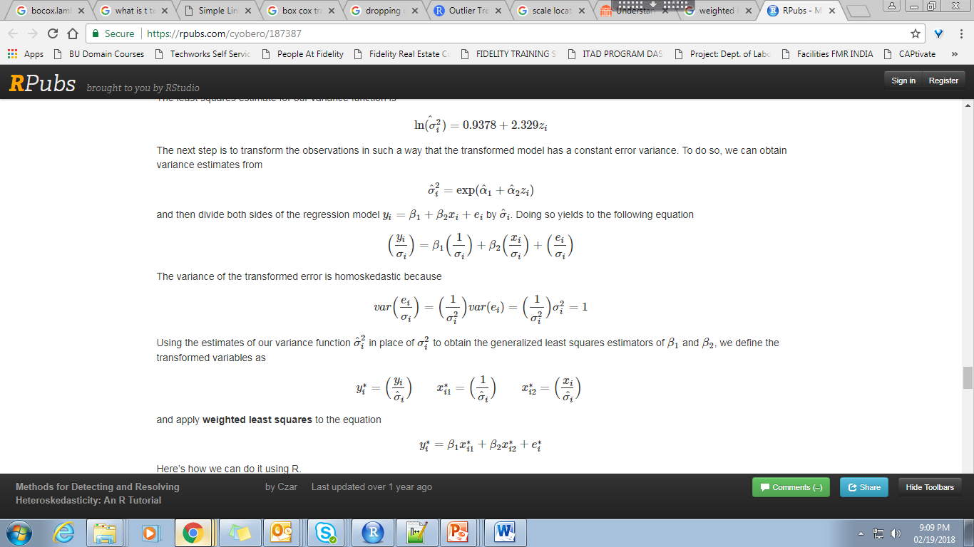
Achieving Homoscedasticity Using Weighted Least Squares
Estimating the alpha-s can be done by using the squares of our least squares residuals as our observations.
Now, the next step is to transform the observations in such a way that the transformed model has a constant error variance.

